Slide 1
Digital Portfolio
STUDENT NAME:P.MANGAIYARKARASI
REGISTER NO AND NMID: asanm22122124ubca013
DEPARTMENT: BACHELOR OF COMPUTER APPLICATION
COLLEGE: COLLEGE/ UNIVERSITY: ST ANN 'S COLLEGE OF ARTS AND SCIENCE/ ANNAMALAI UNIVERSITY

Slide 2
STUDENT PORTFOLIO :
DATA ANALYTICS PLATFORM

Slide 3
AGENDA
Problem Statement
Project Overview
End Users
Tools and Technologies
Portfolio design and Layout
Features and Functionality
Results and Screenshots
Conclusion
Github Link
3/21/2024 Annual Review

Slide 4
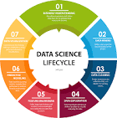
PROBLEM STATEMENT
Problem Statement with ExamplesA data analytics platform problem statement defines a clear business need that can be solved by transforming raw data into actionable insights

Slide 5
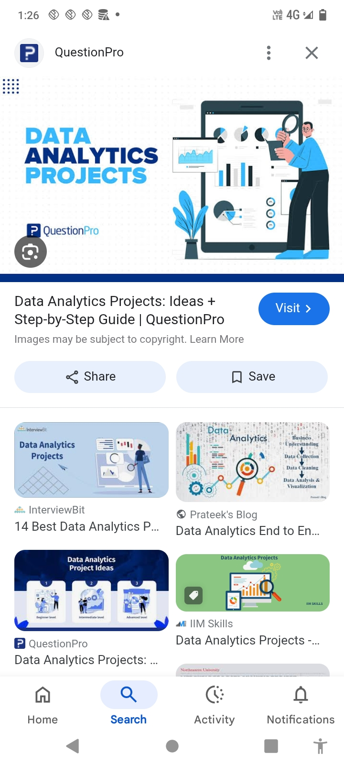
PROJECT OVERVIEW
Understanding the Lifecycle of a Data Analysis ProjectA data analytics platform project overview involves leveraging a software suite to consolidate diverse data sources, enabling users to clean, transform, and analyze information to uncover patterns, trends, and actionable insights for informed decision-making

Slide 6
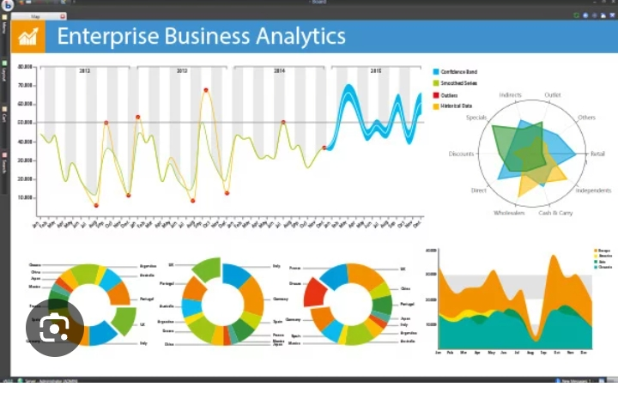
WHO ARE THE END USERS?
How to Build Scalable Solutions
End users engage with data analytics platforms to explore data, generate insights, and make informed decisions by using tools to create custom queries, perform aggregations, and visualize data through dashboards, charts, and graphs

Slide 7
TOOLS AND TECHNIQUES
Data analytics platforms encompass a range of tools and techniques used to collect, process, analyze, and visualize data to extract insights and support decision-making.

Slide 8
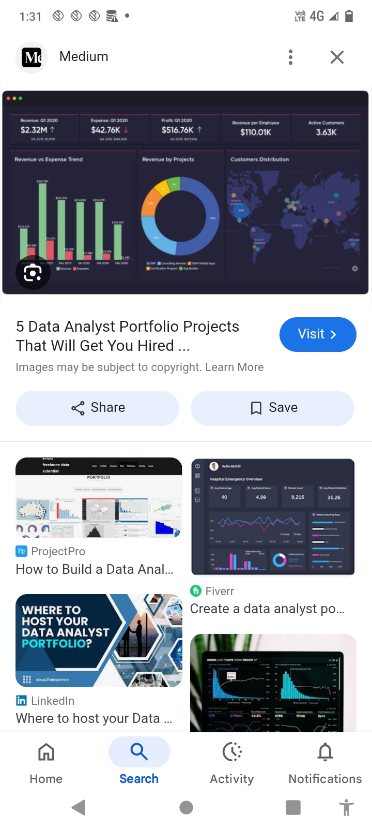
POTFOLIO DESIGN AND LAYOUT
Key design and layout elements include a clear and intuitive navigation, a prominent "About Me" section, engaging project showcases with tangible results, and easy-to-find contact information
8

Slide 9
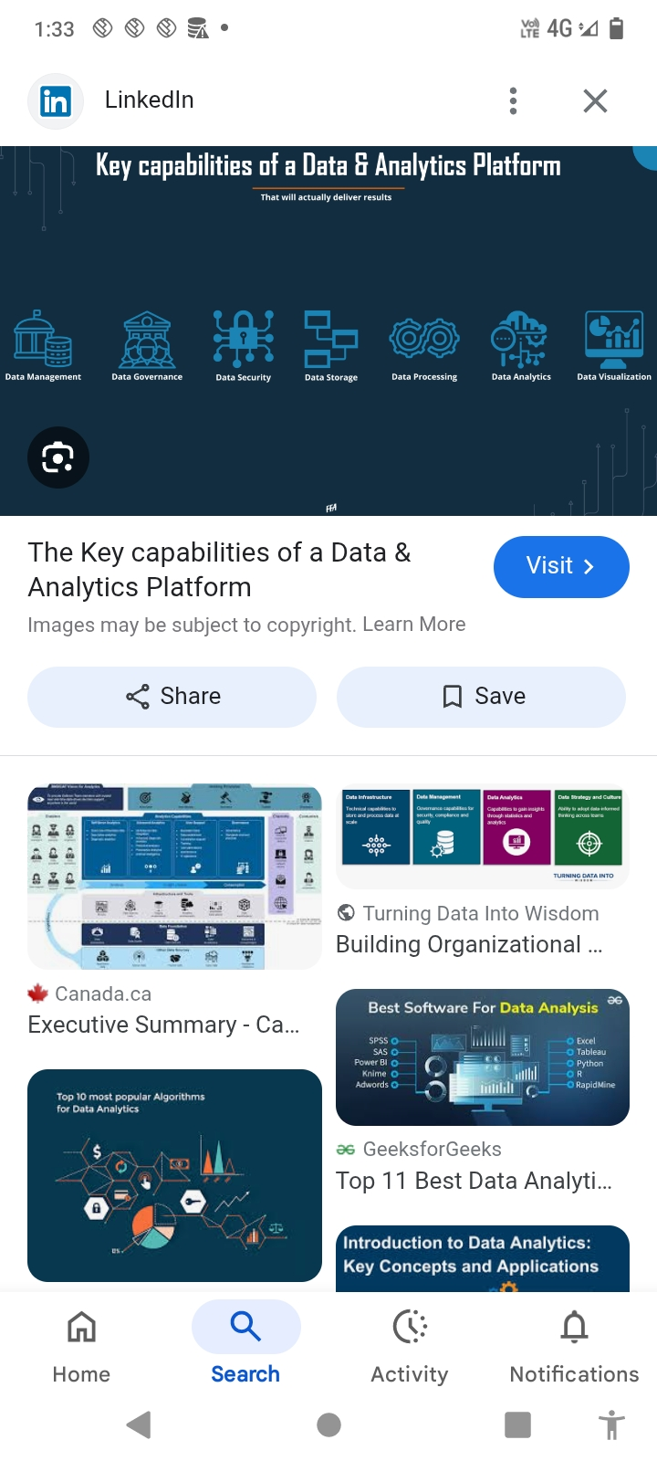
FEATURES AND FUNCTIONALITY
data integration from various sources, robust data processing (including big data and real-time streams), advanced analytics and modeling capabilities (like ML and statistical functions), powerful data visualization tools and interactive dashboards, enhanced collaboration features for teams, and strong data governance for security and compliance

Slide 10
RESULTS AND SCREENSHOTS
A data analytics platform provides a comprehensive interface to view and interact with data, generating reports and dashboards that offer a "snapshot" of key performance indicators and trends, as seen in the Google Analytics overview report.
3/21/2024 Annual Review
10

Slide 11
CONCLUSION
A data analytics platform concludes by enabling businesses to transform raw data into actionable insights, leading to improved decision-making, enhanced operational efficiency, and a competitive advantage
11

Slide 12
GITHUB LINK :
https://github.com/preethi22112005-maker/Mangaiyarkarasi-TNSDCFWD-DP.git
https://github.com/preethi22112005-maker/Mangaiyarkarasi-TNSDCFWD-DP.git
https://github.com/preethi22112005-maker/Mangaiyarkarasi-TNSDCFWD-DP.git

